Slide 1
Reval - Update

Slide 2
Important Fine Print
This presentation has been prepared by Councilperson Solomon. It is not an official document from either the City of Jersey City or Appraisal Systems.
Engage a licensed professional if you need assistance (lawyer, appraiser, financial planner)

Slide 3
Goals & Guests
Goals
Clearly describe the reval process.
Provide actionable information for homeowners
Answer your questions either today…or going forward.
Serve as an advocate for your interests
Share this information

Slide 4
Outline
Reval Basis
How does the reval company come-up with my home’s “assessed value?”
Outline of next steps
Notification of Value
Informal Appeal
Formal Appeal
Tax Bills
Councilperson’s agenda on the reval
Q & A

Slide 5
Outline
Who is this presentation geared toward?
Home and condo owners
Who is this presentation not geared toward?
Renters
Owners of commercial property
Owners of buildings with more than 4 units of housing

Slide 6
What is Revaluation?
A formal, legal process by which the City of Jersey City matches assessed value to market value for every property in the city
Required by NJ state law.
No change in overall taxes collected by Jersey City
Taxes go up, down, or remain the same based on the new assessed value of all properties across the city & the city’s 2018 budget
Who is doing it?
Appraisal Systems Inc.
Two key definitions:
Assessed Value:
Value according to the g’vt.
Static Point-in-Time
Market Value:
Value according to the real estate market
Fluctuates

Slide 7
How did they get the “appraised value?”
2 Part Process
“Improvement Analysis”
Land Value
Mathematical formula based on neighborhood sales
Not on direct sales comps

Slide 8
How did they get the “appraised value?”
Key Metrics of “Improvement Analysis”
Sq. ft.
Based on exterior measurement & satellites.
Not # of rooms
Exterior & interior condition
“Building class”
Bathrooms & Kitchens: # and quality
Basement & Attics – Finish
Heating & Cooling
Flooding
Based on FEMA maps
Additional factors
Views, etc.
All of this information is recorded on your property card
You can review your property card w/Appraisal Systems

Slide 9
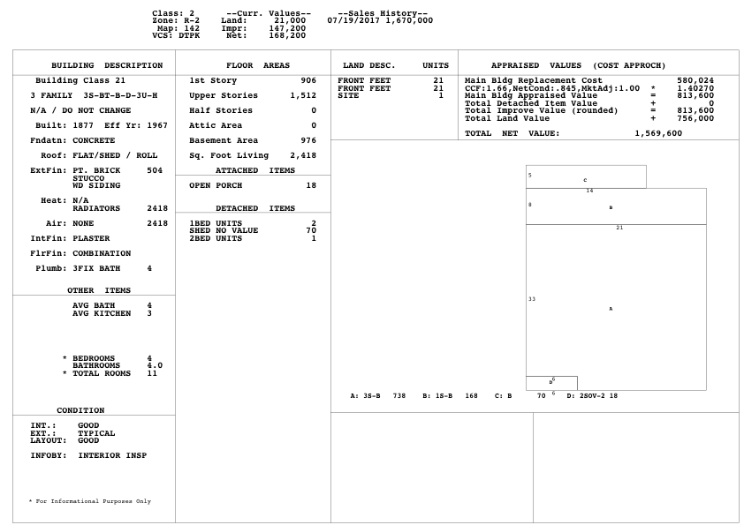
Property Card

Slide 10
Timeline
February 2018
Notification of Value
2018 Assessed value of your home
Estimated 2018 taxes
February-March 2018:
“Informal appeals”
Current deadline is March 15th
City is working with the state/county to extend the deadline.
May 2018
Formal Appeals Deadline for 2018
45 Days from the final certification of home values
Date TBD
July 2018 (or thereabouts)
Final 2018 Tax Bill

Slide 11
Notification of Value
Mailed to owner
Contains
New “assessed value” for home
Estimated 2018 annual taxes
Instructions for
Receiving your property card
Setting up an “informal appeal”
How to get your property card?
Email Appraisal Systems at: jerseycity@asinj.com

Slide 12
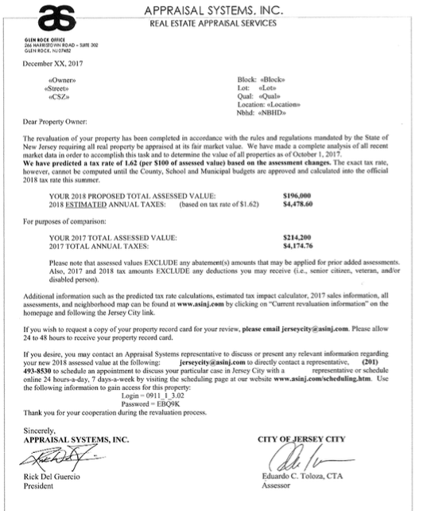
Notification of Value

Slide 13
Notification of Value

Slide 14
Informal Appeal
What is it?
One-on-one meeting to discuss your assessment
Understand all the details of how your home was assessed
Understand sales comps
Make your a case for a reduced assessment
Times:
Wed. 9am-5pm
Thurs. 9am-8:30pm
Sat. 9am-5pm
How to set-up your “informal appeal”:
Email: jerseycity@asinj.com
Call: 201-493-8530
Online: URL and Code on letter

Slide 15
“Informal Appeal”

Slide 16
Informal Appeal: How to prepare
Improvement Analysis
Overall Assessed Value
Check to see if Appraisal Systems’ data is accurate
Requires an inspection from Appraisal Systems.
Call them to set-up an inspection if one hasn’t happened yet
201-493-8530
Request your property card.
jerseycity@asinj.com
Does your overall assessed value compare to similar sales in the area?
PDF of sales data will be on Appraisal Systems website

Slide 17
Informal Appeal: How to prepare
Key Metrics of “Improvement Analysis”
Sq. ft.
Based on exterior measurement & satellites.
Not # of rooms
Exterior & interior condition
“Building class”
Bathrooms & Kitchens: # and quality
Basement & Attics – Finish
Heating
Flooding
Based on FEMA maps
Additional factors
Views, heating & cooling, etc.

Slide 18
Informal Appeal: How to prepare

Slide 19
Formal Appeal
“A Property Assessment Appeal”
A formal process that goes before the Hudson County Tax Board
Strict deadline
45 days after assessments are submitted by the city.
2018 Date TBD
Can only appeal assessments not taxes
Key questions: Is the assessed value of your home accurate? How does it compare to recent sales of similar properties in the neighborhood?
Basic Info
In 2018 (Reval Year)
Assessment must be accurate. Tax Board required to make small adjustments
In 2019 and all non-reval years
Must be outside the “common level range”
Basically, gives the assessor wiggle room
You must demonstrate the market value of your property as of Oct. 1st of the proceeding year
Evidence
Appraisal
Comparable sales (not comparable assessments)

Slide 20
Tax Bills
Key point:
Homeowners are responsible for their FULL 2018 Tax Payment (the estimated # on your form)
2018 estimated taxes on the “Notification of Value” are not the actual tax liability for the year. It is subject to change based on the adoption of the CY2018 budget later this year.

Slide 21
Tax Bills: Example
Note: These numbers are sample. They were picked purely for their facility in demonstrating tax payments
Year | Annual Tax Bill
2017 | $10,000
2018 | $20,000
2019 | $20,000

Slide 22
Tax Bills
Year | Annual Tax Bill
2017 | $10,000
2018 | $20,000
2019 | $20,000
Year | 1st Quarter TP | 2nd Quarter TP | 3rd Quarter TP | 4th Quarter TP | Total
2017 | $2,500 | $2,500 | $2,500 | $2,500 | $10,000
Year | 1st Quarter TP | 2nd Quarter TP | 3rd Quarter TP | 4th Quarter TP | Total
2019 | $5,000 | $5,000 | $5,000 | $5,000 | $20,000
Year | 1st Quarter TP | 2nd Quarter TP | 3rd Quarter TP | 4th Quarter TP | Total
2018 | $2,500 | $2,500 | $7,500 | $7,500 | $20,000

Slide 23
Councilperson Solomon Reval Agenda
Short-Term (next two months)
Serve as advocate for DTJC.
Answer Qs
Advocate w/City & Reval company
Spread information

Slide 24
Councilperson Solomon Reval Agenda
Medium Term (2-6 months)
Door-to-door senior freeze sign-ups
Advocate for free/sliding scale financial planners
Subject all fiscal decisions to strict scrutiny
Introduce legislation to reform reval process to rolling assessments on an annual or 5-year basis
Explore policy changes to receive full state & local deduction
Charity donation tax credit
Phase-in

Slide 25
Councilperson Solomon Reval Agenda
Long Term (2019)
Analyze reval / tax changes on the downtown housing market.
If steep decline in property values, work with city & assessors office on broad based solutions.
Continue to subject all fiscal decisions to strict scrutiny

Slide 26
Conclusion
My personal recommendations – Short-Term
Request your property card
Set-up an “informal appeal”
Call me w/questions & see how I can help
jsolomon@jcnj.org
Cell: 201-744-6732

Slide 27
Impact of Federal Tax Changes
Each person will be different.
State and Local Tax Deduction
Up to a maximum of $10K per filing
Increase in “standard deduction”
$12K per person
Elimination of the personal exemption
Contact your tax preparer to better understand these impacts on your situation

